Slide 1


Slide 2
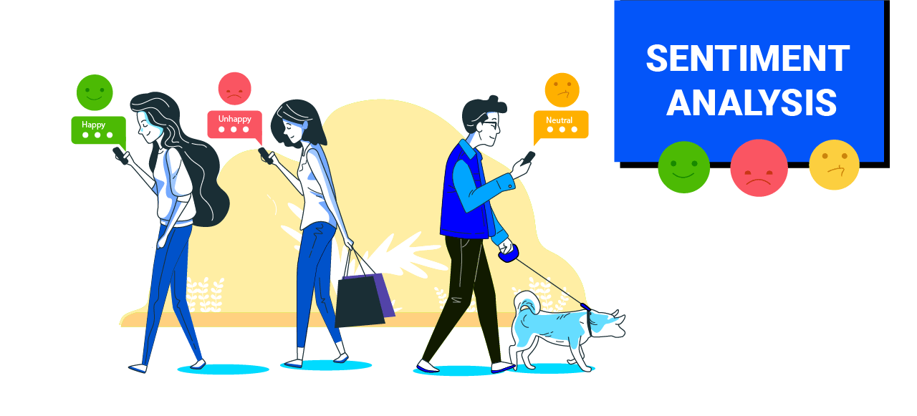

Presented by :- Esha Anthwal (14AI058) Harshit Bangwal (14AI059) Kshitij Singhal (14AI062)
Mentor:-
Dr. Yogesh Bhatt

Slide 3
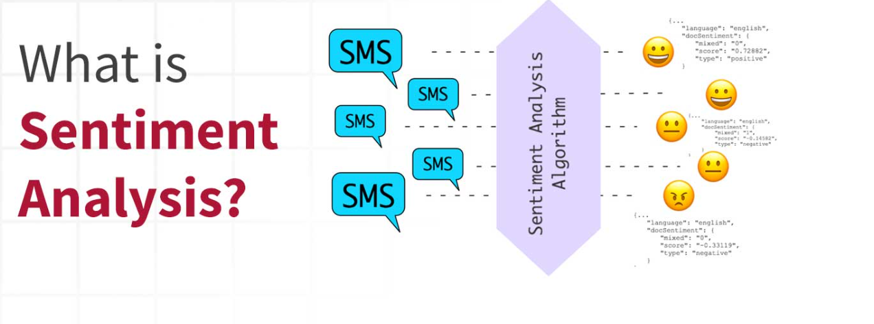
INTRODUCTION

Slide 4
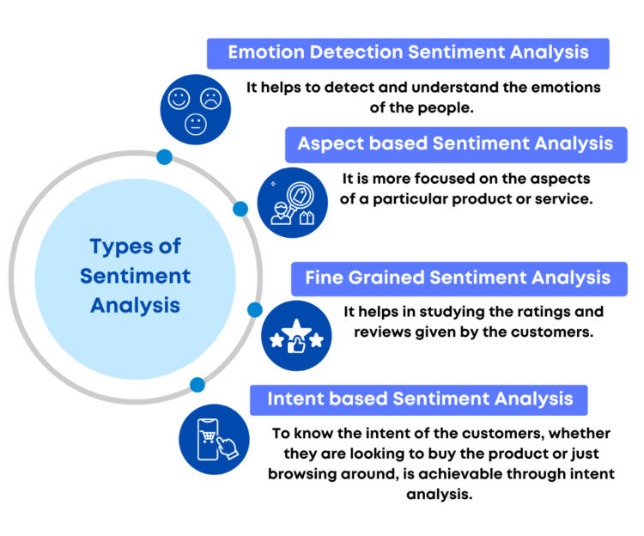

Slide 5

NLP
Natural language processing is a field of computer science, artificial and linguistics with the intelligence, and linguistics concerned with the interactions between computers and human (natural) languages.
The sentiment function of textblob library provides polarity and subjectivity values of the each occurring tweet.

Slide 6

OBJECTIVES
Twitter-most common platform, convenient source -updated, informed –events occurring.
Tweets- biased, individual opinions, impossible access all tweets. solid decision.
This paper, we filter tweets -comparative analysis, judgment of situation- more accurately
We connected ,twitter backend -twitter developer account, TextBlob-Tweet analysis.
After polarities, we analyze-public opinions - product or service.
Then we provide positive ,neutral and negative percentage for the tweets associated with word provide by the user.

Slide 7




Software’s Requirement :-
Anaconda Navigator- GUI - launches applications easily manages coda packages, environments.
Jupyter Notebook -Open-source web application-create and share documents -live code, equations, visualizations, narrative text.
Python - High-level general-purpose programming language.
A twitter developer account - Access twitter API, and get assigned Four keys - Consumer secret key, Consumer key, Access token secret, and access token.

Slide 8

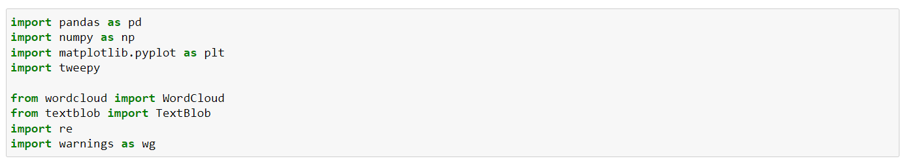
Libraries
NUMPY
PANDAS
MATPLOTLIB
TWEEPY
WORDCLOUD
TEXTBLOB
RE- removal of mentions, URLs, hashtags, etc.
Warnings

Slide 9
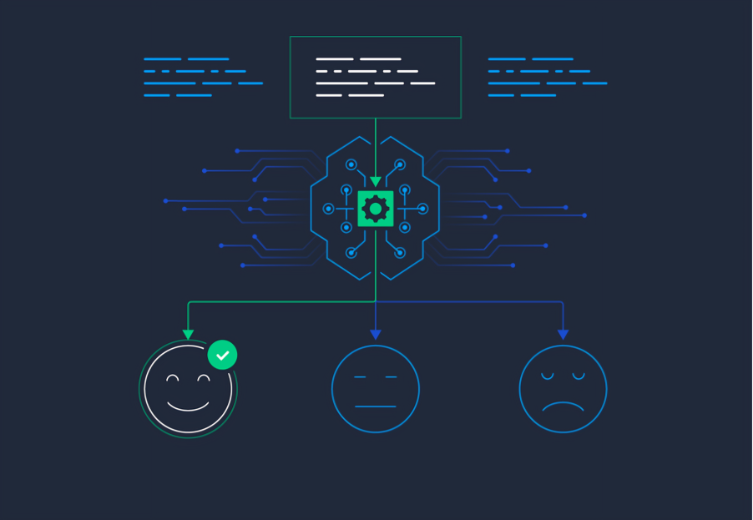
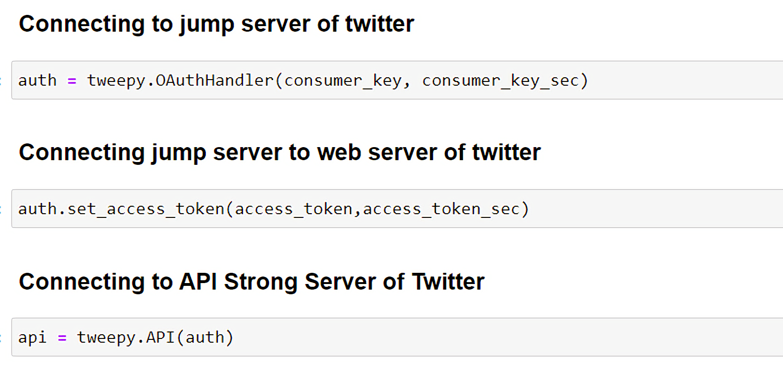
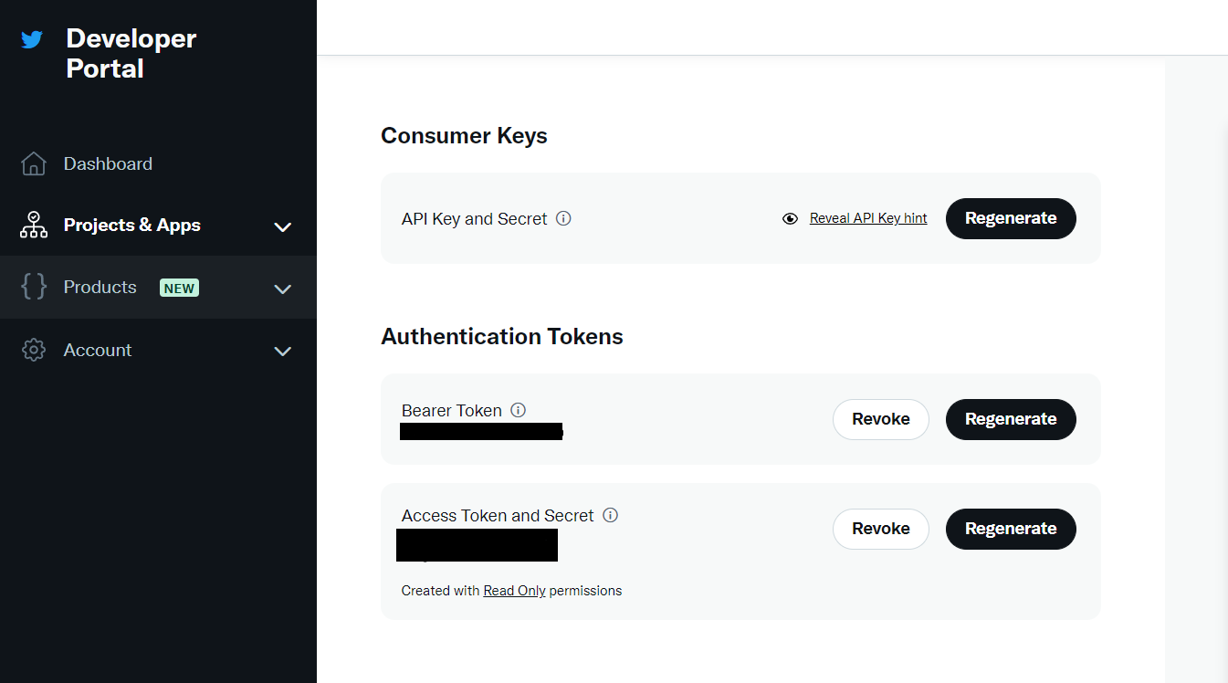
ESTABLISHING CONNECTION

Slide 10

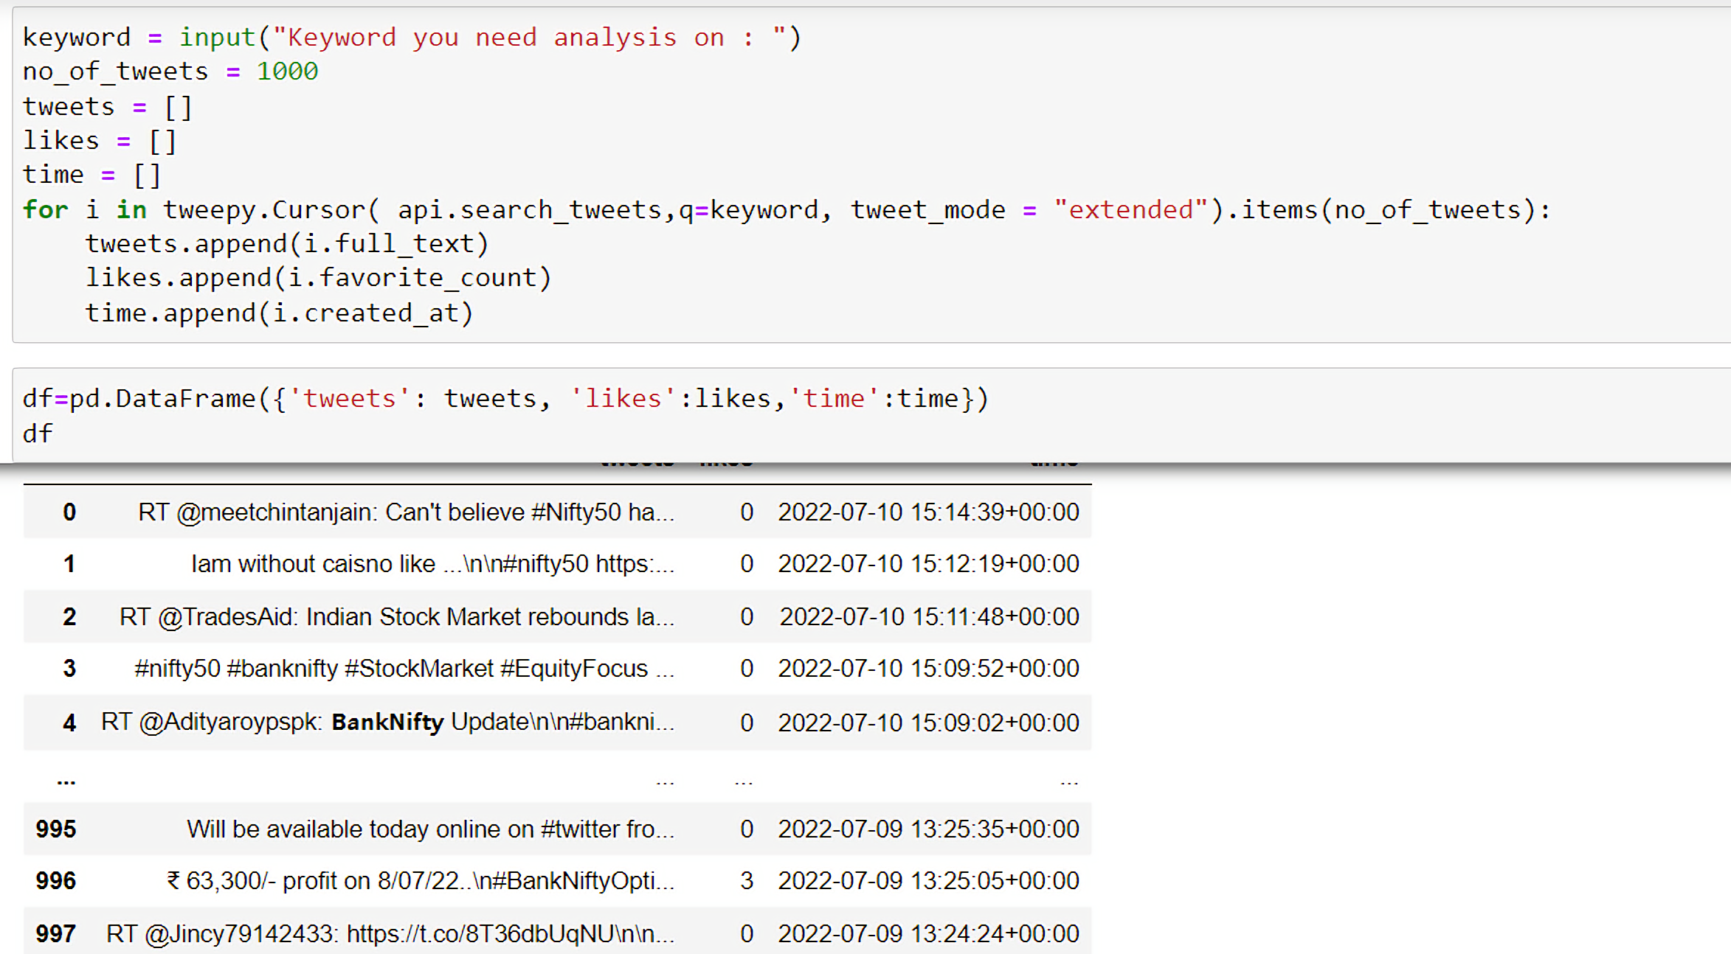
TWEETS EXTRACTION

Slide 11

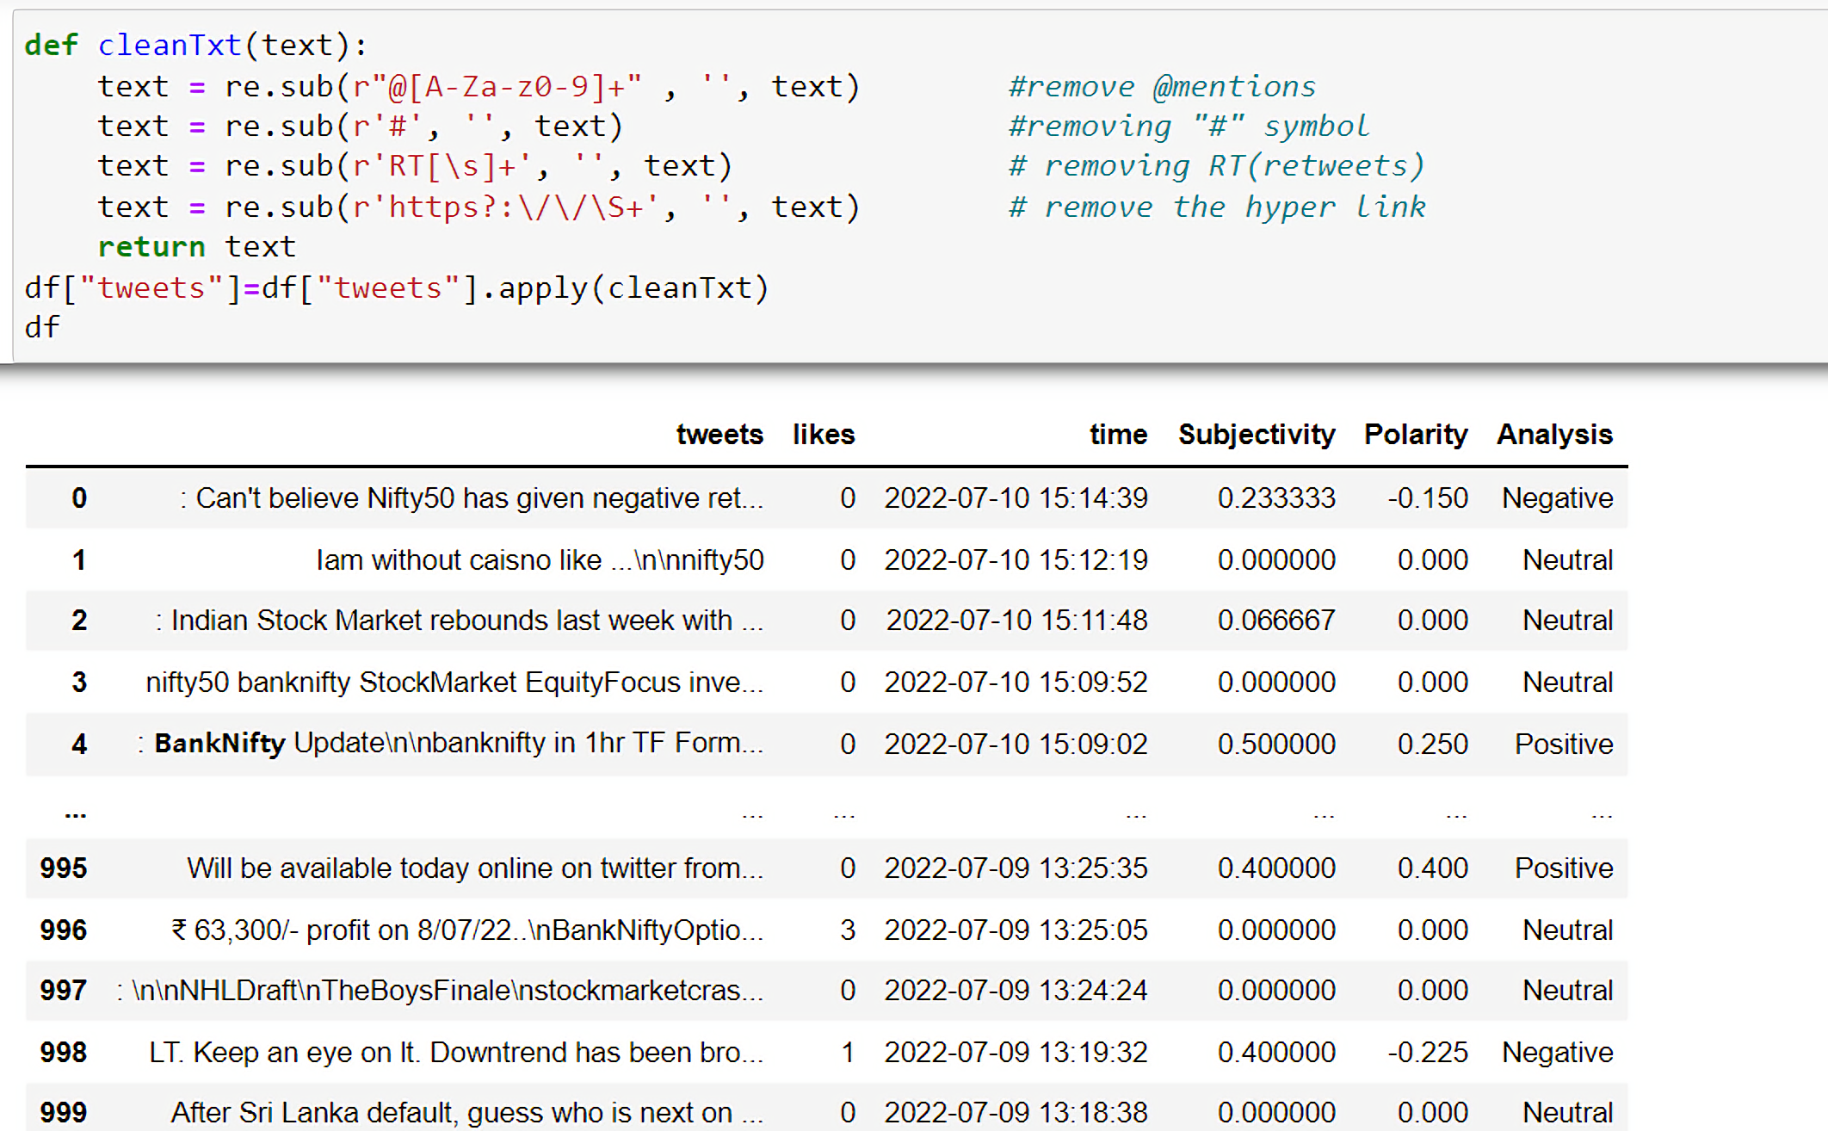
CLEANING TWEETS

Slide 12

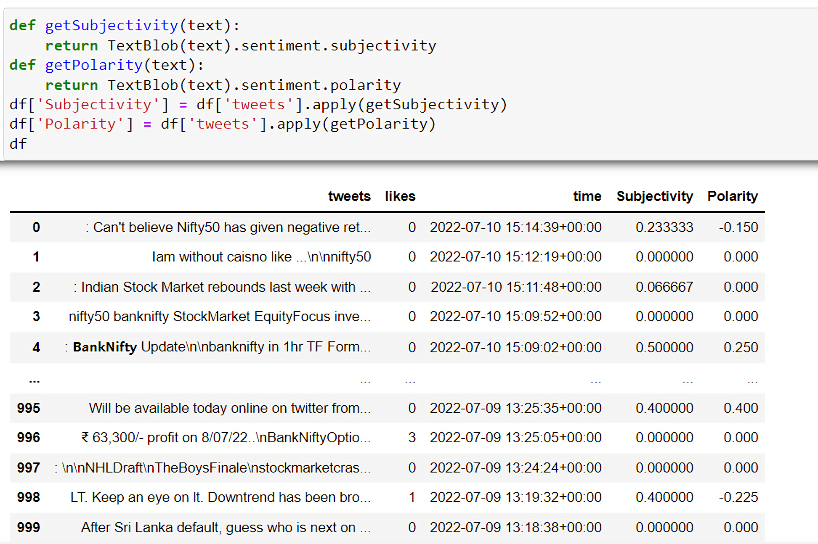
Subjectivity and Polarity

Slide 13

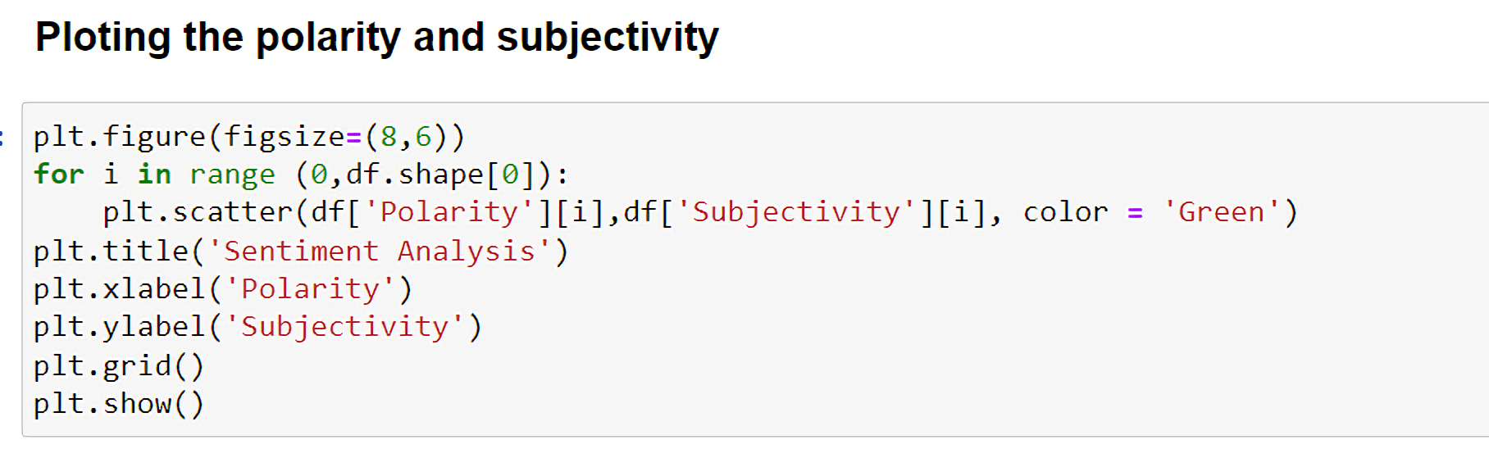
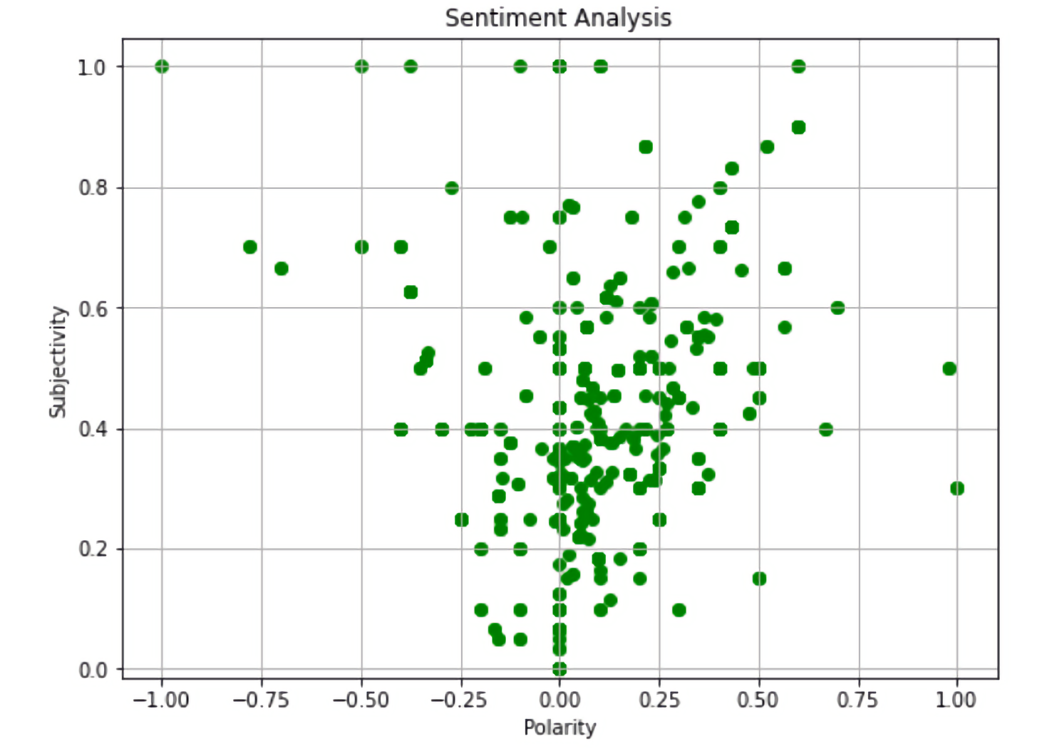
PLOTTING THE POLARITY AND SUBJECTIVITY

Slide 14
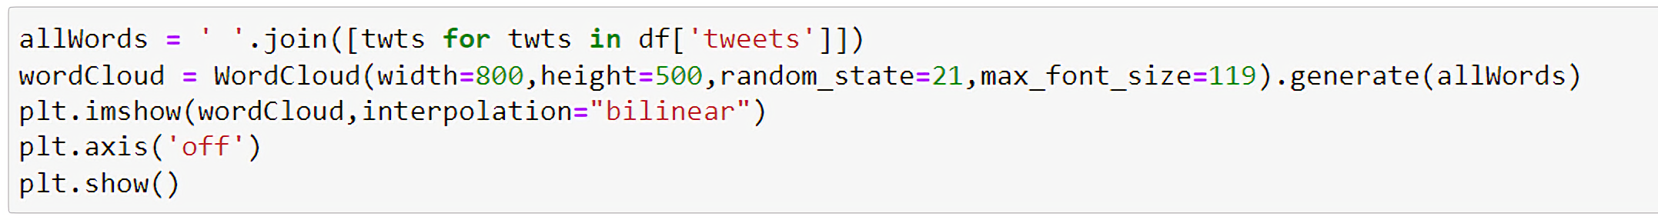
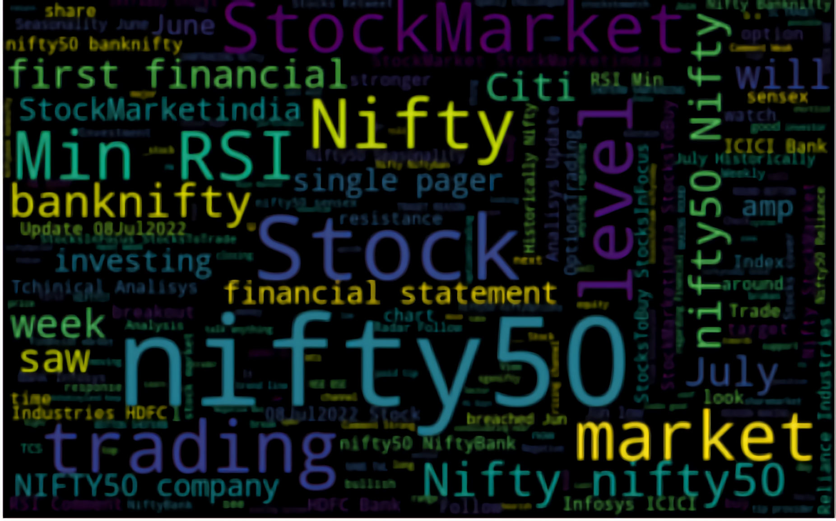
WORD CLOUD

Slide 15
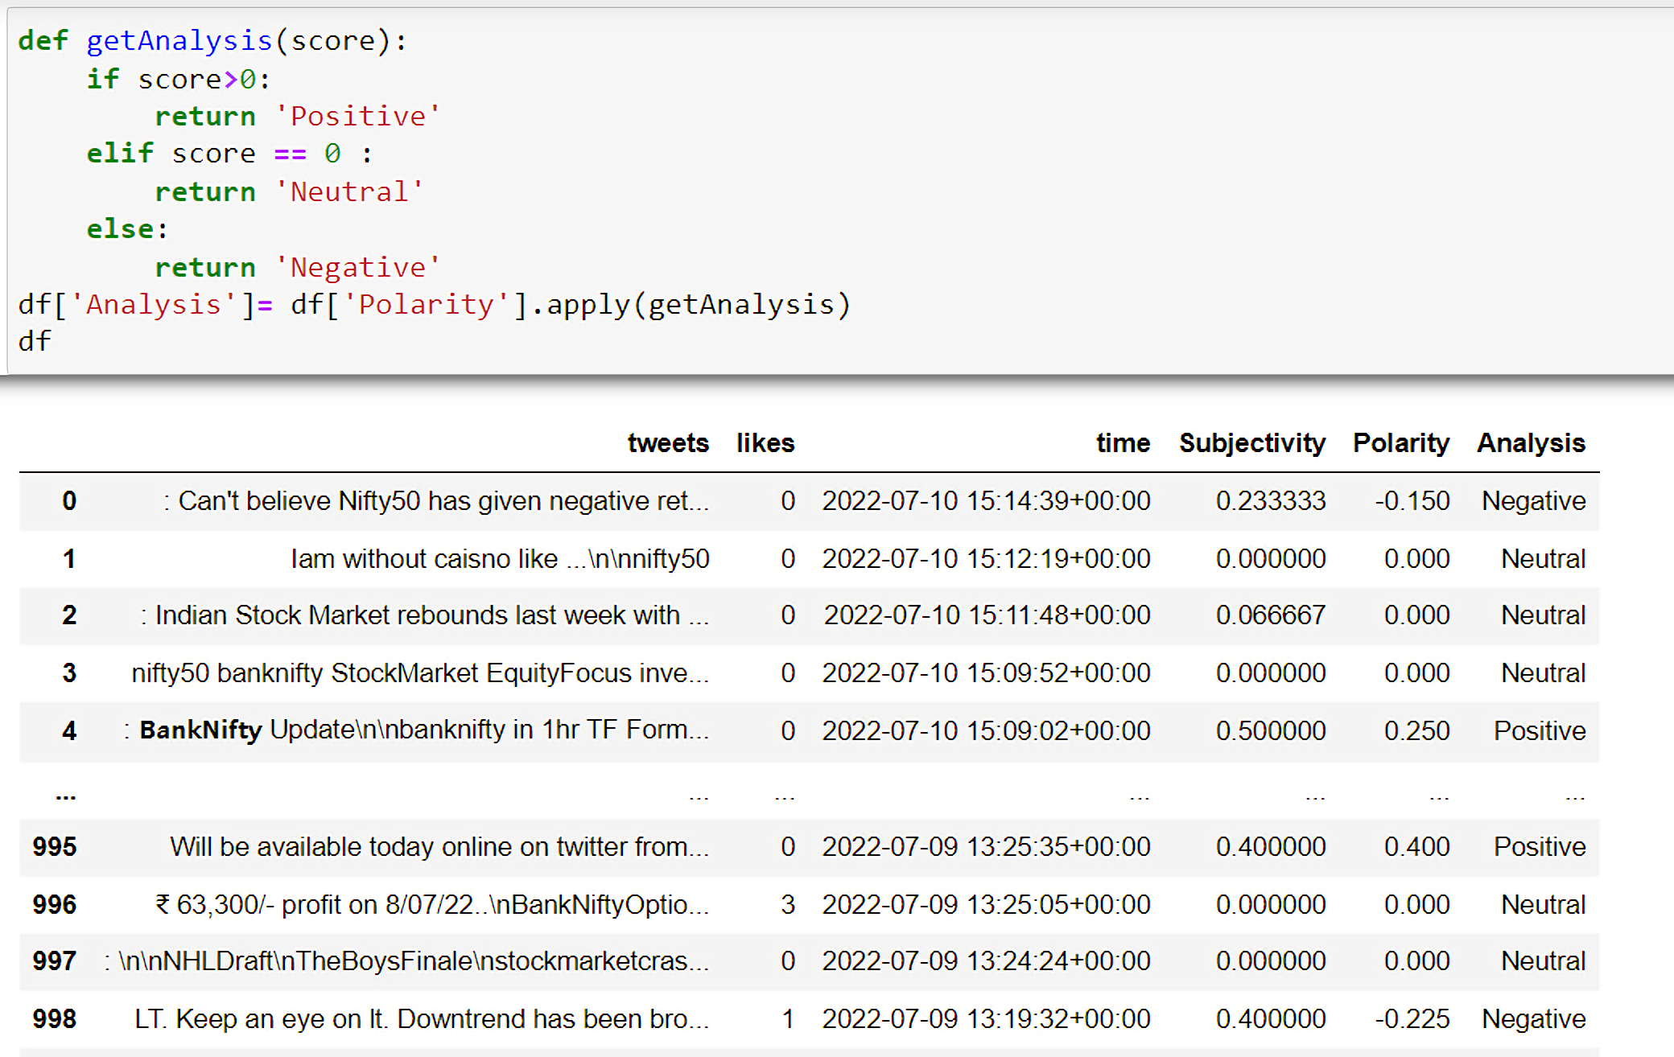
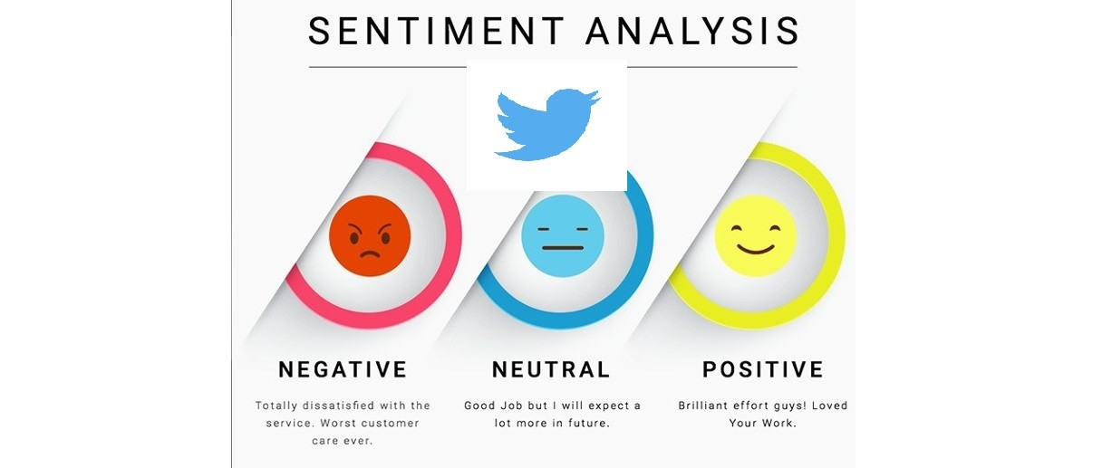
DETERMINIG INCLINATION OF TWEETS

Slide 16

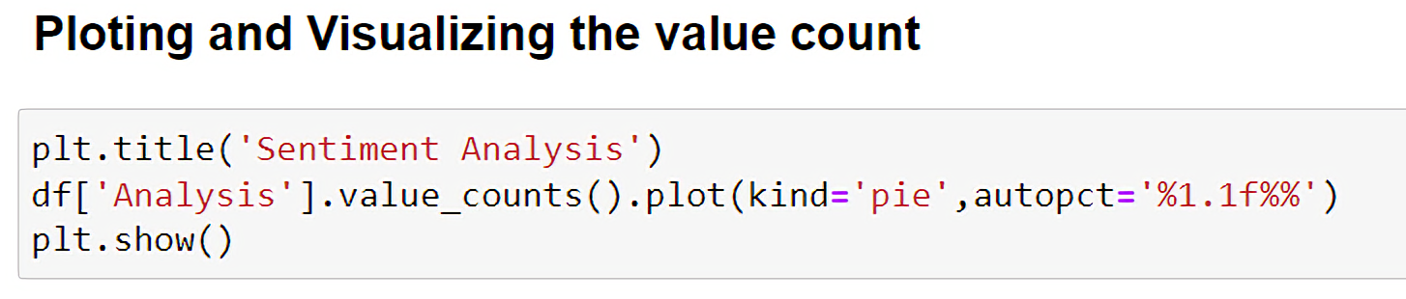
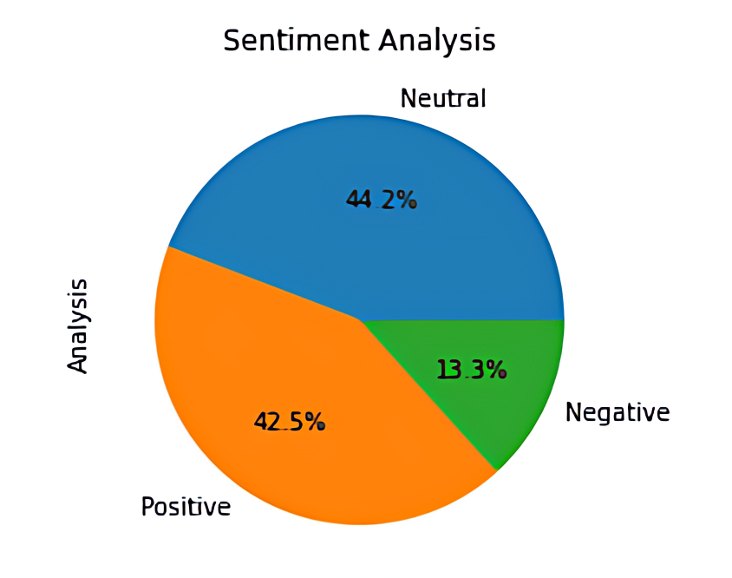
Plotting Pie-Chart

Slide 17

CONCLUSION
Sentiment analysis/ opinion mining -wide area -real time applications, has many research limitations.
Since fast internet growth, internet related applications, Sentiment Analysis – most interesting research area- natural language processing community.
Our project - we analyzed -sentiments ,Tweets - extracted from Twitter , and classify them according polarities of the tweets.

Slide 18
Major Limitations
Spam and fake reviews detection.
Classification Filtering limitation.
Very complex -analyzing short texts, limited information.
Irony, humor, negations, and emoticon in tweets- sentiment analysis tools -not much effective.
Analyses suitable -English language, limitation- other languages.

Slide 19

Areas for future sentiment analysis
Spam Detection Sentiment.
Sentiment Analysis- short Sentence, short text.
Improvement -sentiment word identification.
Development- automatic analyzing tool.
Accurate Analysis - policy related content.
Proper classification - bipolar sentiments

Slide 20
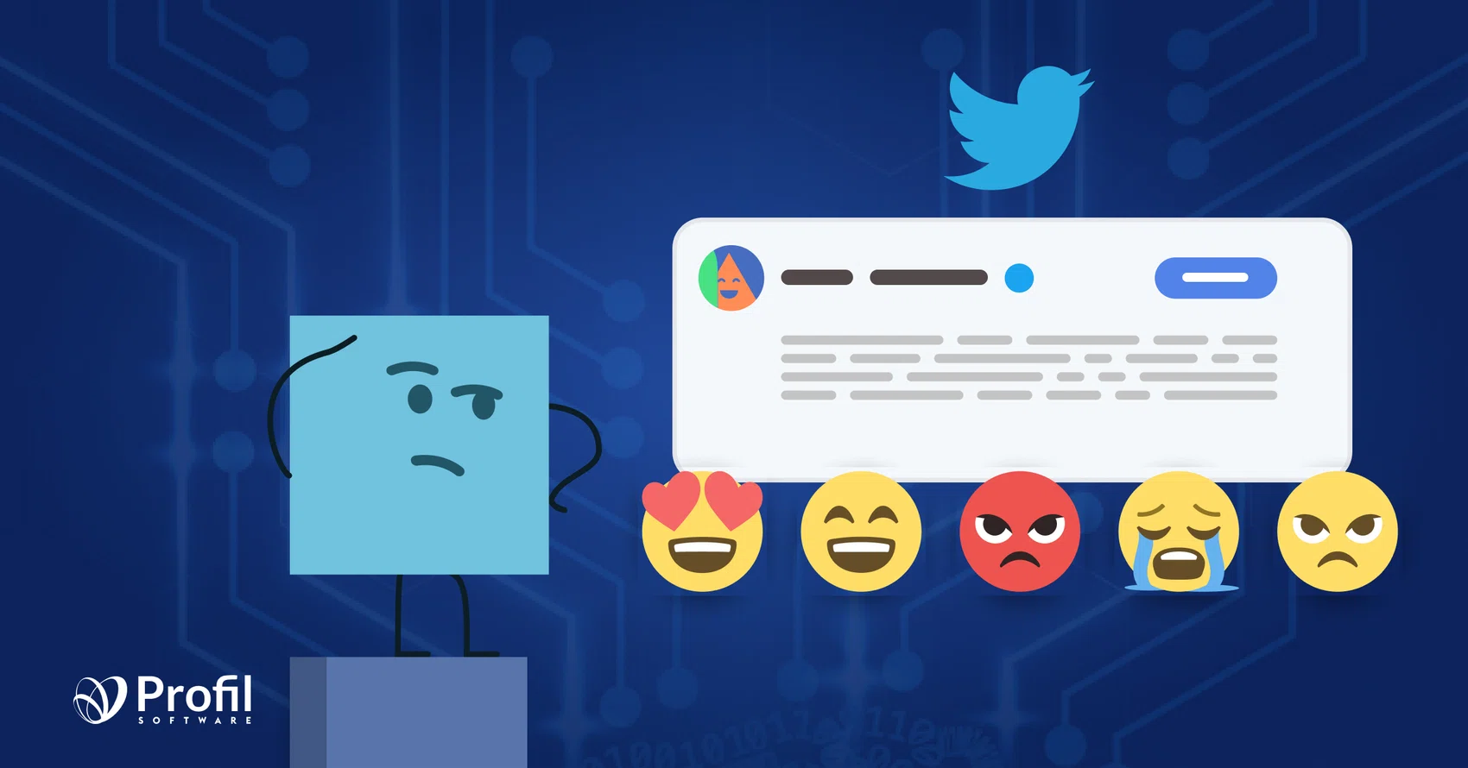
THANKYOU

